Slide 1
Project Benson: MTA Turnstile Data Analysis
Our approach to maximize the outreach of WomenTechWomenYes in New York

Slide 2
The Project
WomenTechWomenYes (WTWY) solicited our engagement to use MTA subway data to help them optimize the placement of their street teams, such that they can gather the most signatures, ideally from those who will attend the gala and contribute to our cause.

Slide 3
Assumptions
Higher traffic results in more fundraising
Locals with high income interested in the cause of WTWY are more likely to contribute
Leverage the MTA data with demographics (women population, etc) can provide better insights

Slide 4
The Challenges
MTA data is difficult to understand
Census data is tricky to extract based on location
In some cases, turnstile counters reseted and counts jumped to a completely different value.
MTA with Census data have different location dimensions and station names.

Slide 5
Exploring the Data (MAN)
Data cleaning and pre-processing
Groupby
Max min
Daily mean

Slide 6
Exploring the Data
Fluxogram of merge of data

Slide 7
Exploring the Data (ALANDO)
[ALANDO TELL STORY OF MISSING GOOGLE ZIP DATA]
[ALANDO TALK ABOUT FUZZYWUZZY AND SCORING]
[ALANDO TALK ABOUT MERGING GEO DATA W/ MAIN DATA]

Slide 8
Exploring the Data
Graph busiest stations (average traffic for the last year)
Graph traffic stations per weekday
Graphs for demographics

Slide 9
Ranking the Stations
Score
Traffic
Women ratio
In tech zone
Income
How can we create a composite measure from multiple variables?

Slide 10
Composite weighted score
Explanatory Variables
Variable | Weight
Traffic | 3
Women ratio | 2
Income | 2
In tech zone | 1
Normalized Explanatory Variables
Scores
Weighted score rank

Slide 11
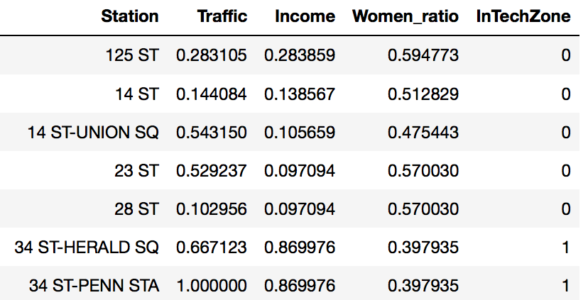
Composite weighted score
Normalization method: min-max
Scales the data between the 0 and 1
Results easy to visualize
Explanatory Variables
Normalized Explanatory Variables
Scores
Weighted score rank

Slide 12
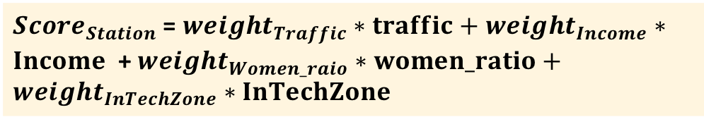
Composite weighted score
Explanatory Variables
Method: weighted scoring
Variables weighted according to the priority of the criteria
Normalized Explanatory Variables
${Score}_{Station}$ = ${weight}_{Traffic}∗traffic+$ ${weight}_{Income}∗Income$ + ${weight}_{Women_raio}∗women_ratio+{weight}_{InTechZone}∗InTechZone$
Scores
Weighted score rank

Slide 13
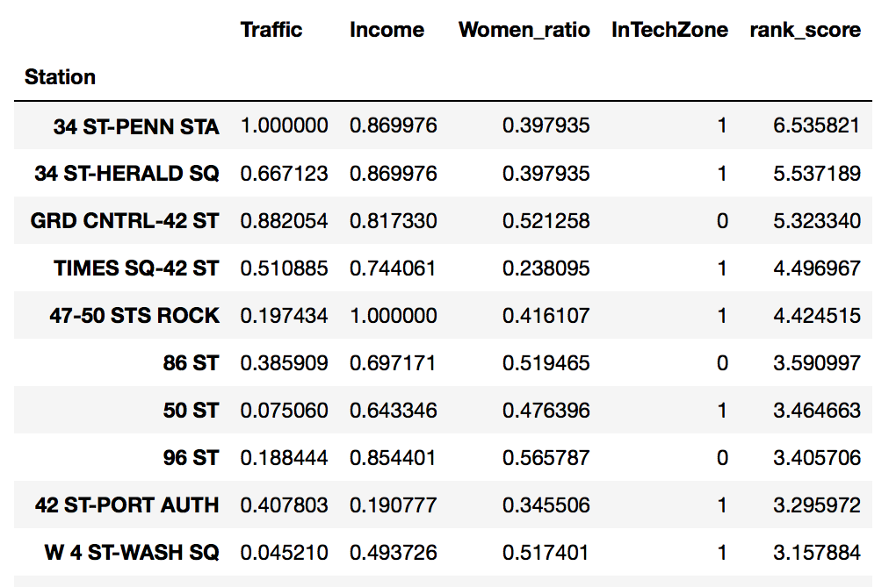
Composite weighted score
Explanatory Variables
Normalized Explanatory Variables
Scores
Weighted score rank

Slide 14
Recommendations
Chosen areas on map

